Slide 1


TOPIC - APPLE’S INC. BRANDING STRATEGY
PRESENTED BY:-
KAUSHIKI VIJAYVARGIYA | 234024008
MAYANK MANGAL | 234024011
MAKRAND MISHRA | 234024009
PRAKRUT DESAI | 234024015
UNDER THE GUIDANCE OF –
DR. SUMANT KUMAR

Slide 2
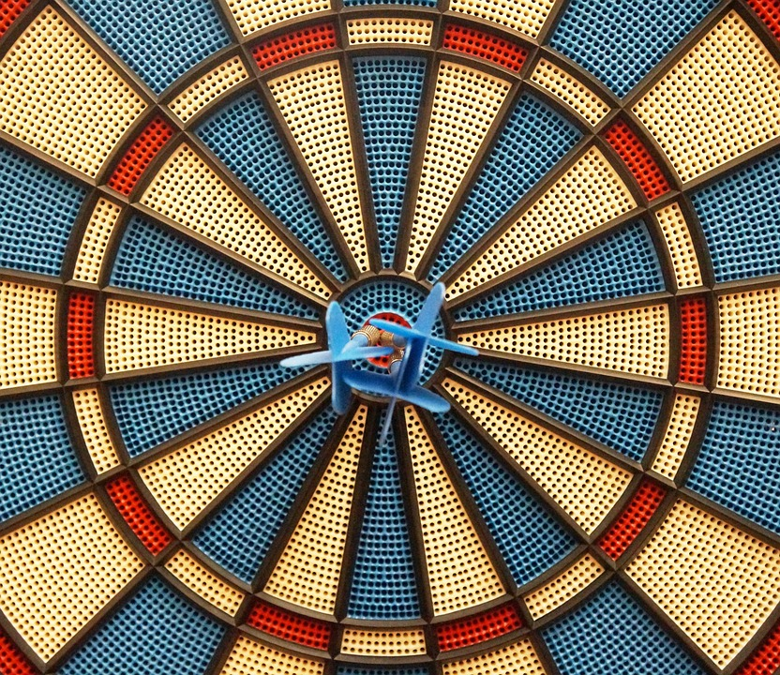
OBJECTIVES OF THE PROJECT: -
To Understand the Vision, Mission and core values of the company.
To understand the Strategic Management process.
To analyze various External and Internal forces acting on the company.
To understand the Company’s Generic Strategy

Slide 3
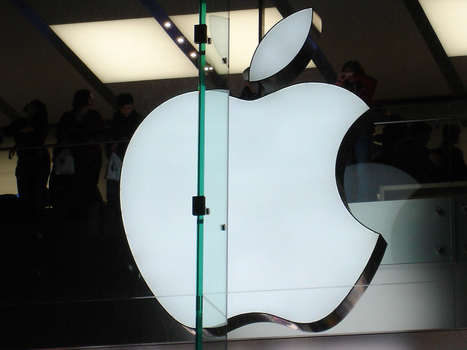
APPLE INC.

Slide 4
Company: Apple Inc.
CEO: Tim Cook
Year founded: 1976
Headquarter: Cupertino, California, USA
Employees (2022): 164,000
Market Cap (Mar 2023): $2.29 Trillion
Annual Revenue (FY2022): $394.32 Billion
Profit | Net income (FY2022): $99.8 Billion
Products & Services: Computers | Software | Phones | Watches | Tablets | Cloud Technology | Accessories | Music Platform
Competitors: Microsoft | Lenovo | Google | Samsung | Toshiba | Dell | Sony | HP | Acer | Netflix | Disney | Amazon |

Slide 5
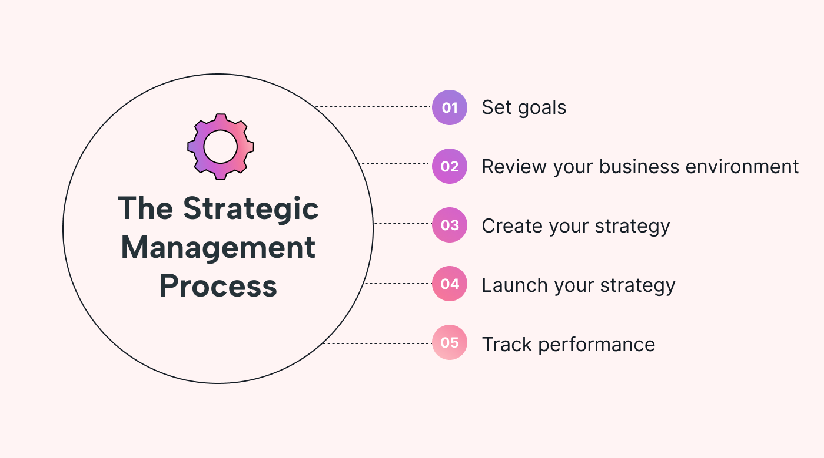

Slide 6
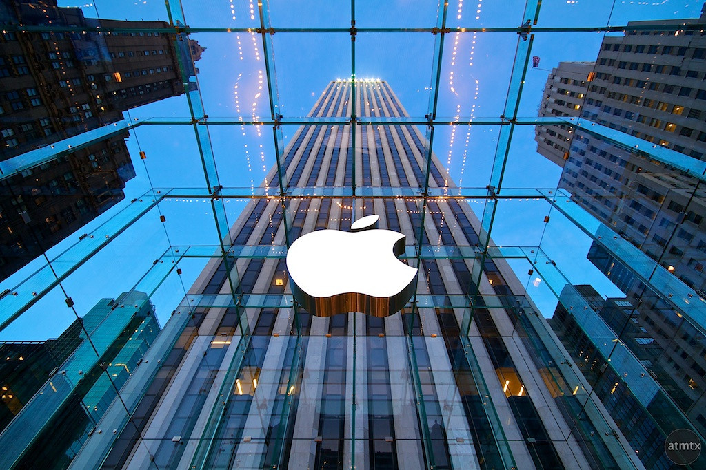

Slide 7
APPLE’S VISION STATEMENT
“To bringing the best user experience to customers through innovative hardware, software and services.”

Slide 8
APPLE’S MISSION STATEMENT
“To make the best product on the earth and to leave the world better than we found it.”

Slide 9


CORE VALUES
EDUCATION
ENVIRONMENT
ACCESSIBILITY
PRIVACY
SUPPLIER
RESPONSIBILITY
INCLUSION AND DIVERSITY
Racial Equity and Justice Initiative

Slide 10

COMPANY’S FINANCIAL AND STRATEGIC OBJECTIVE
To lead the technology market by continuing to emphasize innovation.
To ensure that it keeps expanding its market reach.
Enter and sustain premium pricing while attempting
to gain market share.
Increase profit margins.
Sustain and expand on strongly branded name.

Slide 11

GENERIC COMPETITIVE STRATEGY OF APPLE INC
LOW COST PROVIDER
BROAD DIFFERENTIATION
FOCUS LOW-COST STRATEGY
FOCUSSED DIFFERENTIATION STRATEGY
BEST COST PROVIDER STRATEGY

Slide 12
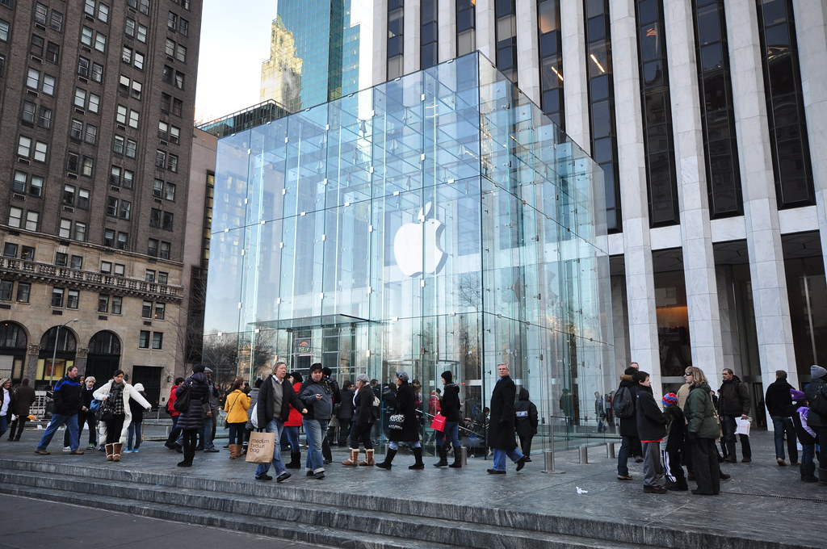

Slide 13
EXTERNAL
ANALYSIS

Slide 14




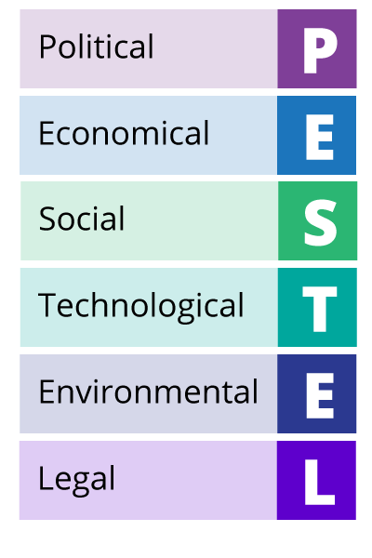
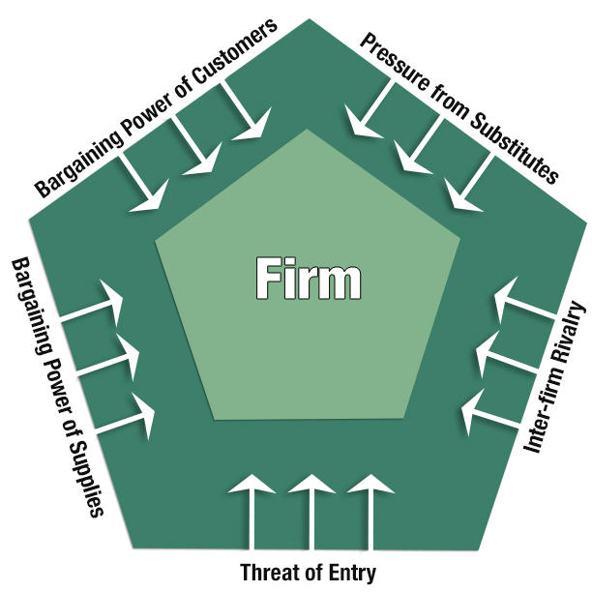






MACRO-EXTERNAL
ENVIRONMENT
MICRO-EXTERNAL
ENVIRONMENT
EXTERNAL STRATEGIC FACTORS

Slide 15


Trade tensions
Government regulations
Political instability
Global economic slowdown
Fluctuating currency exchange rates
Rising inflation
Shifting consumer preferences
Increased focus on privacy
Diversity and inclusion
P
E
S
T
E
L
ANALYSIS

Slide 16



Rapid technological advancements
Cybersecurity threats
Disruptive technologies
Climate change regulations
Resource scarcity
Consumer demand for sustainable products
Intellectual property lawsuits
Data privacy regulations
P
E
S
T
E
L
ANALYSIS

Slide 17
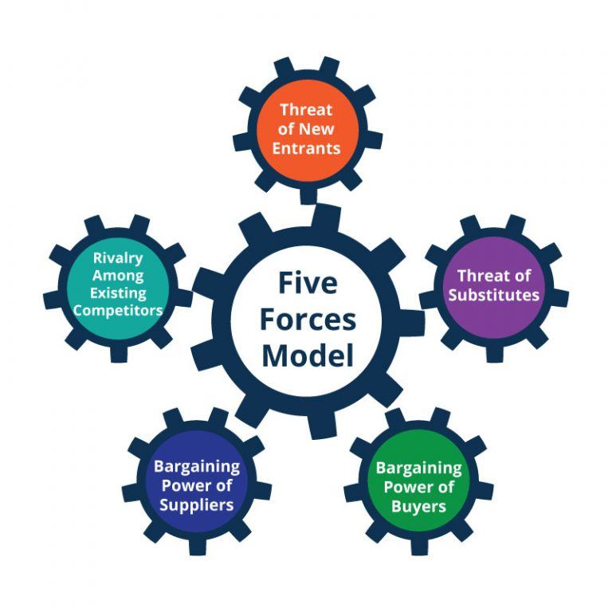






Slide 18
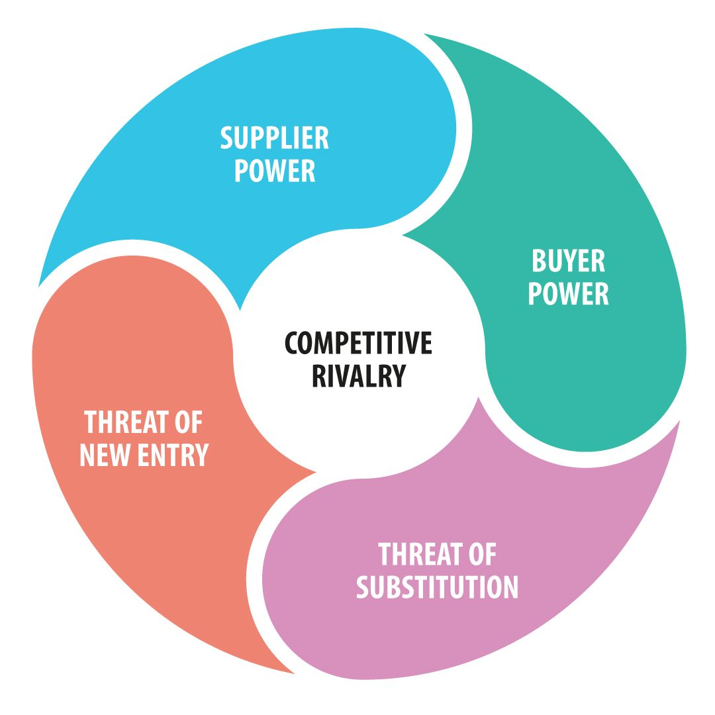
Apple’s supply and demand
Switching costs for suppliers is high
Multiple component suppliers
Switching costs
Alternative brands
Segmented Buyer Base
Economies of scale
Huge capital investment
High barrier to entry
Brand loyalty
Patents
Dynamic international business environment.
Other computing devices
Diverse product portfolio
Existing and established players
Gaming laptops
Pricing mechanism

Slide 19

PORTER’S FIVE FORCES | EFFECT/COMPETITION/THREAT
THREAT OF POTENTIAL NEW ENTRANT | Moderate – Low
BARGAINING POWER OF SUPPLIER | Low – Moderate
BARGAINING POWER OF BUYERS | Moderate – High
THREAT OF SUBSTITUE PRODUCT AND SERVICES | Moderate
INTENSITY OF COMPETITIVE RIVALRY | High

Slide 20
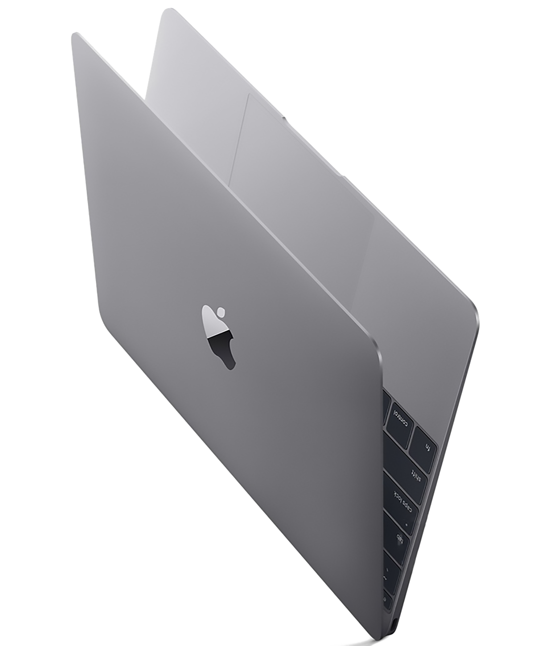

STRATEGIC
GROUP MAPPING
This Photo by Unknown Author is licensed under CC BY-NC

Slide 21
MANY
Peripheral integration
VS
Features
LENOVO,
ASUS
FEW
FEW
BASIC
ROBUST
ROBUST

Slide 22
2. Design/Support
VS
Price
HIGH
GALAXY BOOK
GALAXY BOOK
HP,DELL
LENOVO,
ASUS
LOW
ELEGANT
BASIC
EXTENSIVE
SUPPORT

Slide 23
HIGH
3. Model Variety
VS
Performance/Reputation
GALAXY
BOOK
LENOVO,
ASUS
LOW
FEW
FEW
ROBUST
MANY

Slide 24


Slide 25
S
O
A
R
STRENGHTS
OPPORTUNITIES
ASPIRATIONS
RESULTS
Brand image and loyalty
Innovation and technology
Diversification of product line
Global expansion
Market leadership
Sustainability initiatives
Customer centric
Market share growth
Innovative recognition

Slide 26
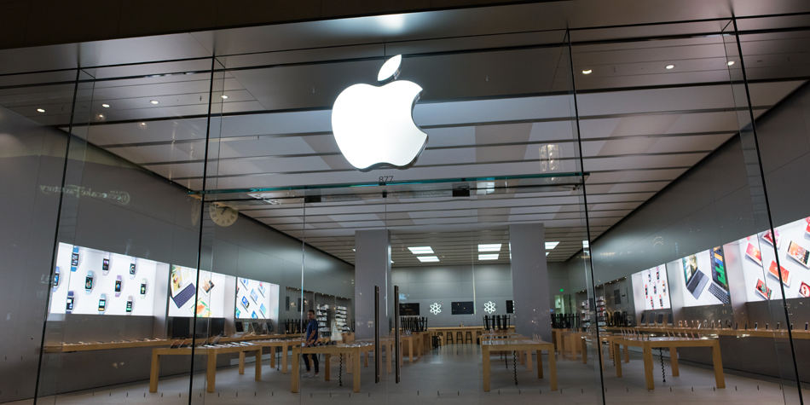

Slide 27
INTERNAL
ANALYSIS

Slide 28

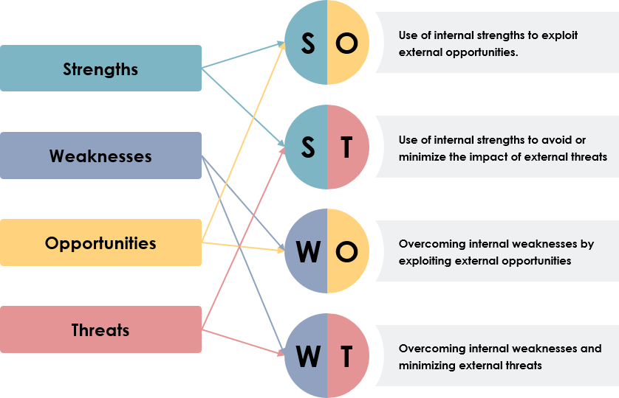

Slide 29
SWOT ANALYSIS
STRENGTHS
Strong brand name
Vertical and horizontal integration
WEAKNESS
High price
Product offering vs expectation
OPPORTUNITIES
Emerging markets
Opening more retail stores
Innovation
Product popularity
Design capabilities
Wide distribution
Aggressive marketing efforts
Ecosystem of products
Business strategy
Low market share
CSR
New product line
Evolution of digital technology
Integrating AI
S
W
O
T
THREATS
Competition from rivals
Leak of products before launch
Dynamic business environment
Risk of international operations
Risk of imitation and piracy.

Slide 30




RESOURCES
Manufacturing, supply chain along with strong distribution network.
Brand, design expertise, innovation and talent pool
CAPABILITIES
Product development
Customer service
Intellectual property
Marketing and branding
Supply chain management – product delivery.
C
A
P
A
B
I
L
I
T
I
E
S
R
E
S
O
U
R
C
E
S

Slide 31
VRIN TESTING
RESOURCE/CAPABILITY | VALUE | RARITY | IMITABILITY | ORGANIZATION
Brand Reputation | ✓ | ✓ | ✗ | ✓
Product Design and UX | ✓ | ✓ | ✗ | ✓
Ecosystem of Services | ✓ | ✓ | ✗ | ✓
Financial Performance | ✓ | ✓ | ✗ | ✓
Design Patents | ✓ | ✓ | ✓ | ✓
Exclusive Supplier Agreements | ✓ | ✓ | ✓ | ✓
Retail Store Experience | ✓ | ✓ | ✗ | ✓

Slide 32
VRIN TESTING
RESOURCE/CAPABILITY | VALUE | RARITY | IMITABILITY | ORGANIZATION
Culture of Secrecy | ✓ | ✓ | ✓ | ✓
Integrated Ecosystem | ✓ | ✓ | ✓ | ✓
Supply Chain Management | ✓ | ✓ | ✓ | ✓
Leadership and Vision | ✓ | ✓ | ✗ | ✓
Organizational Culture | ✓ | ✓ | ✗ | ✓
Financial Resources | ✓ | ✓ | ✗ | ✓

Slide 33
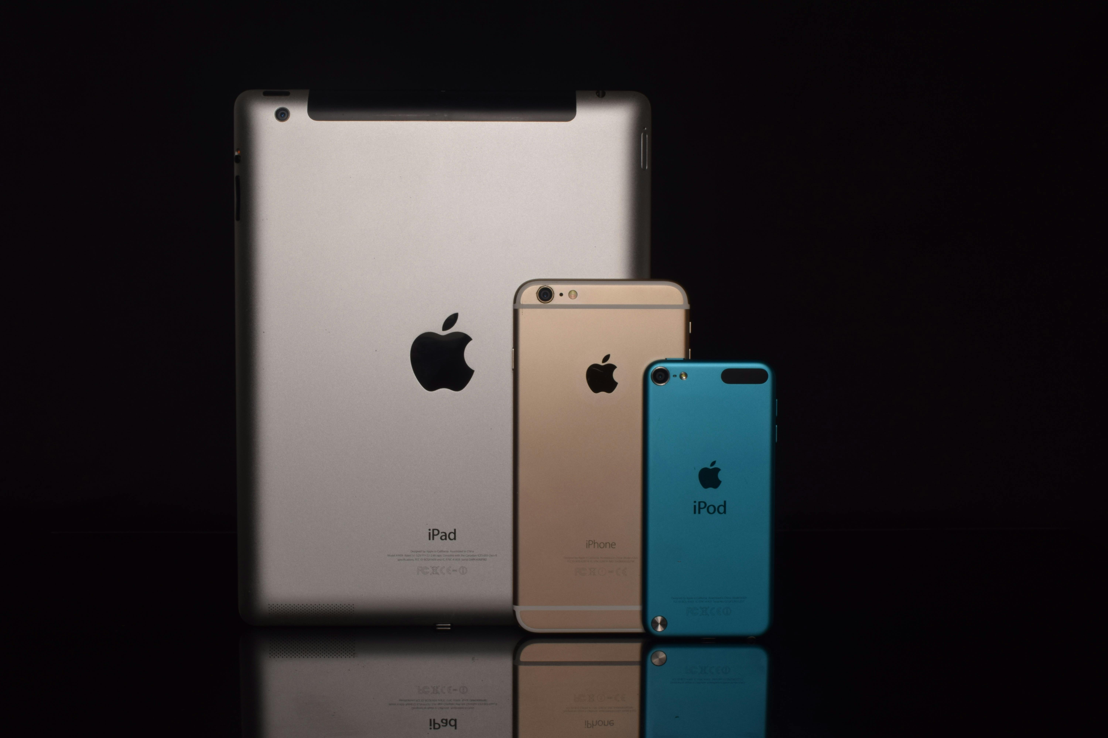
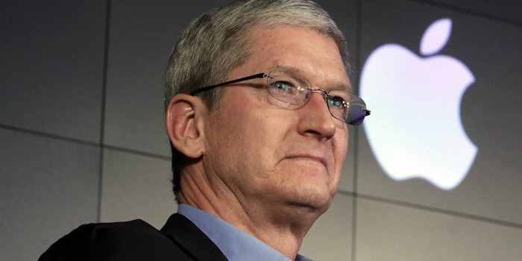
TOWS MATRIX
FOR
STRATEGIC SUGGESTION

Slide 34
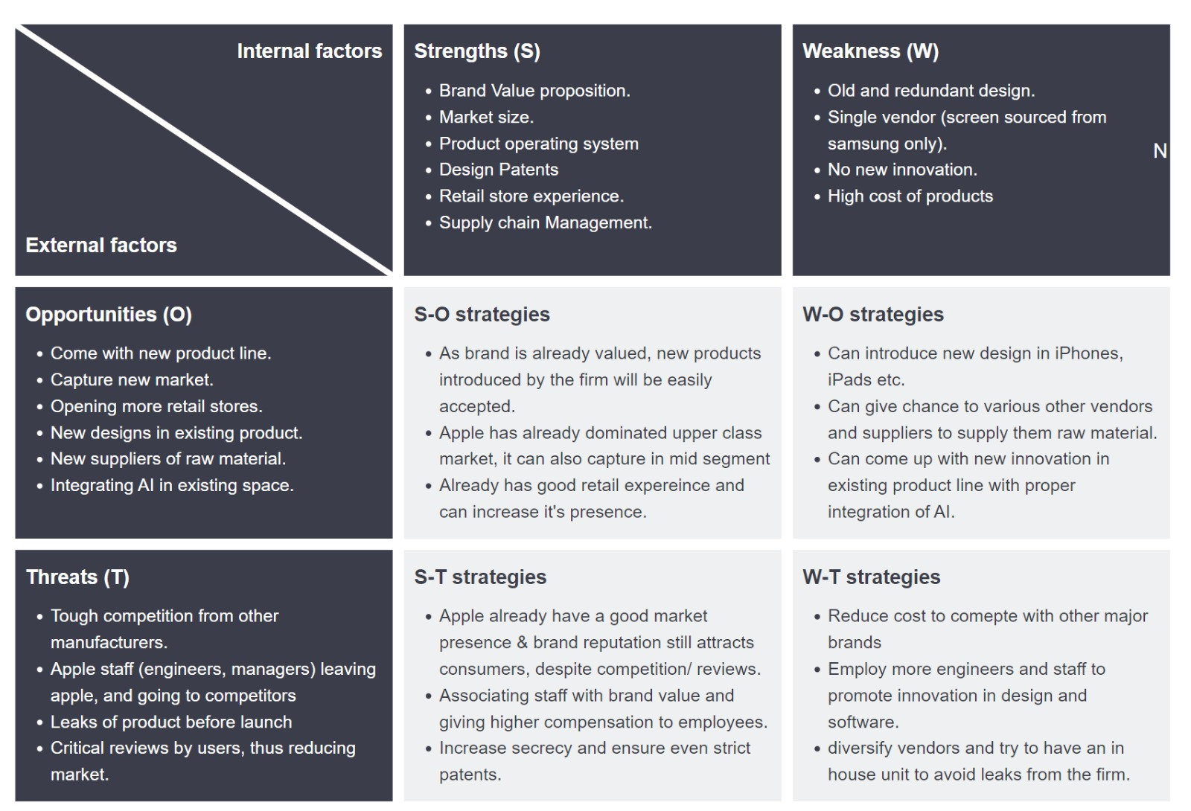

Slide 35

BUSINESS LEVEL STRATEGY
Unique features with superior quality
High customer service and outsourcing services
CORPORATE LEVEL STRATEGY
Branding efforts
Moderate to high level diversification
Educational sales
Media fodder – maintain brand curiosity
R and D, patent and innovations
Vertical and horizontal integration

Slide 36


